Slide 1

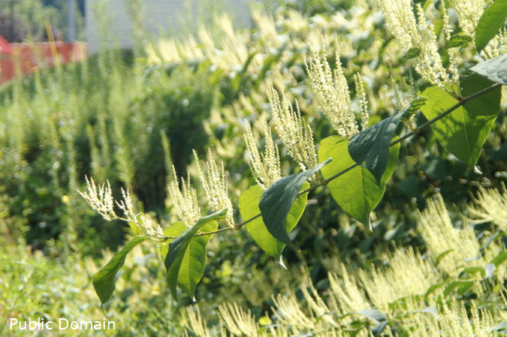


A barrier to global plant invasion ecology: gaps in trait availability for alien species
Matthias Grenié, Petr Pyšek, Franz Essl, Patrick Weigelt, Holger Kreft, Mark van Kleunen, Wayne Dawson, Ingolf Kühn, Helge Bruelheide, Marten Winter
Neobiota 2022 – Tuesday 13th of September 2022
matthias.grenie@idiv.de
@LeNematode
https://rekyt.github.io/

Slide 2
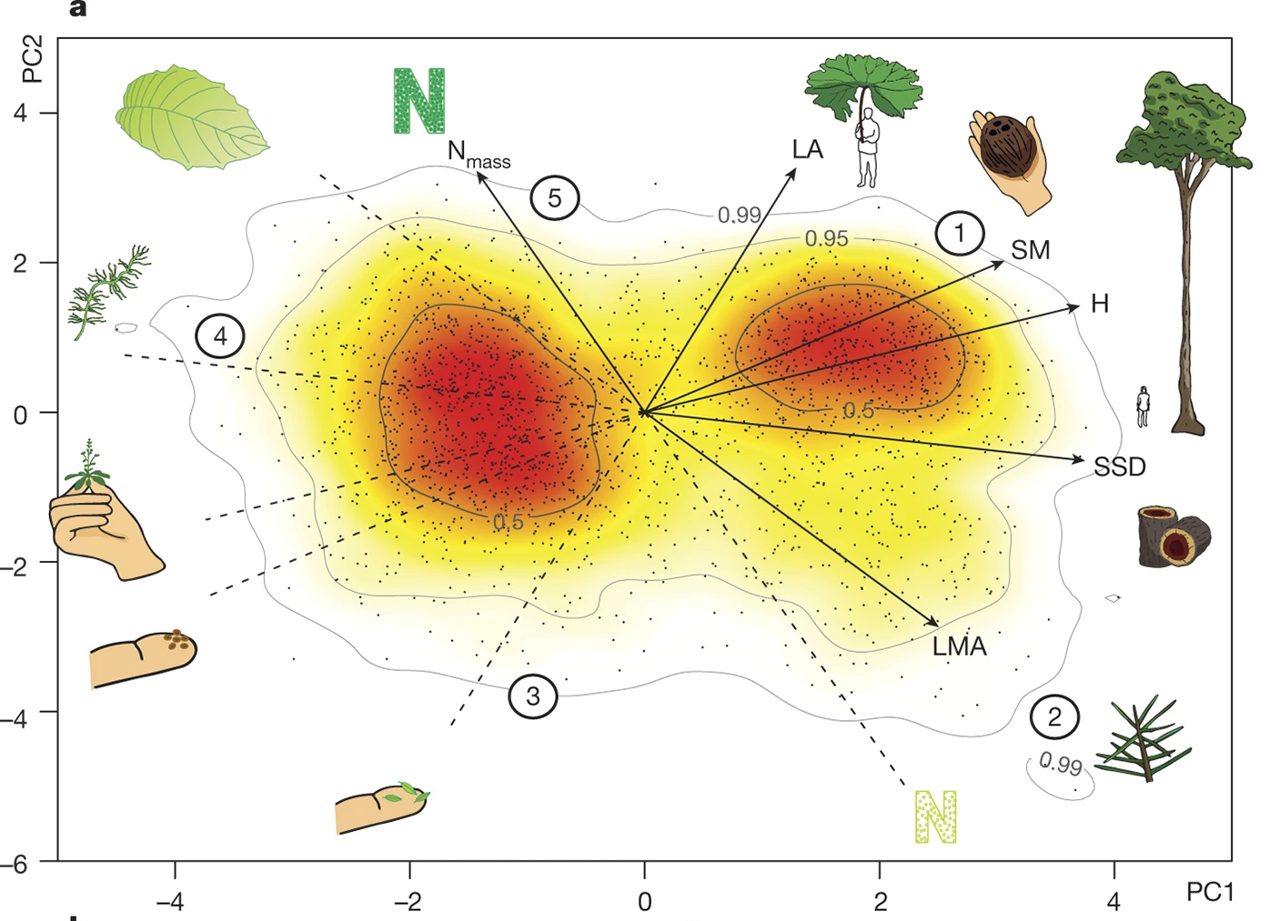
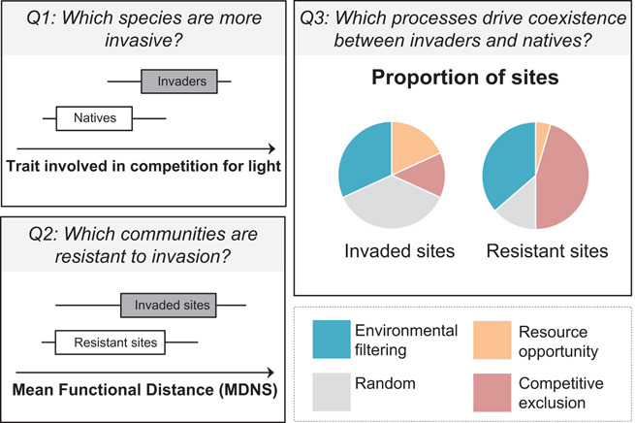
Functional Invasion Community Ecology?
Community Ecology focuses on multiple species together
Functional traits let us gain insight
Díaz et al. 2016
Gallien & Carboni 2016
→ Study community assembly processes of alien species using functional traits
<numéro>

Slide 3
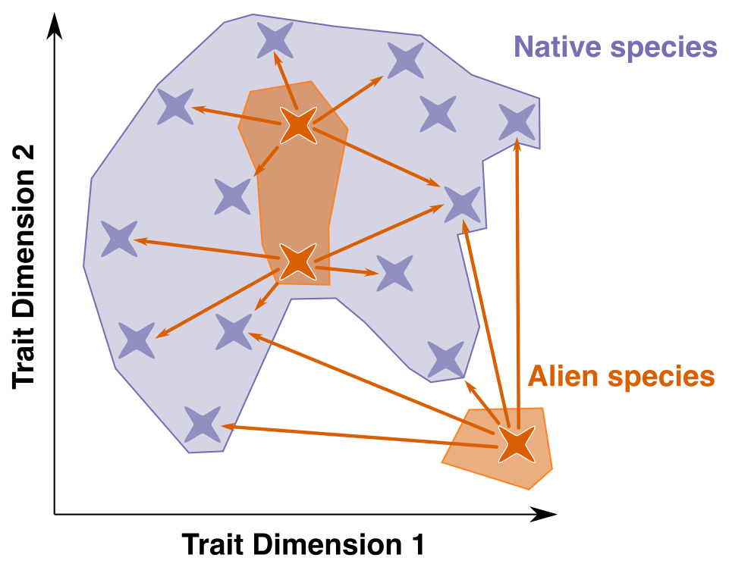
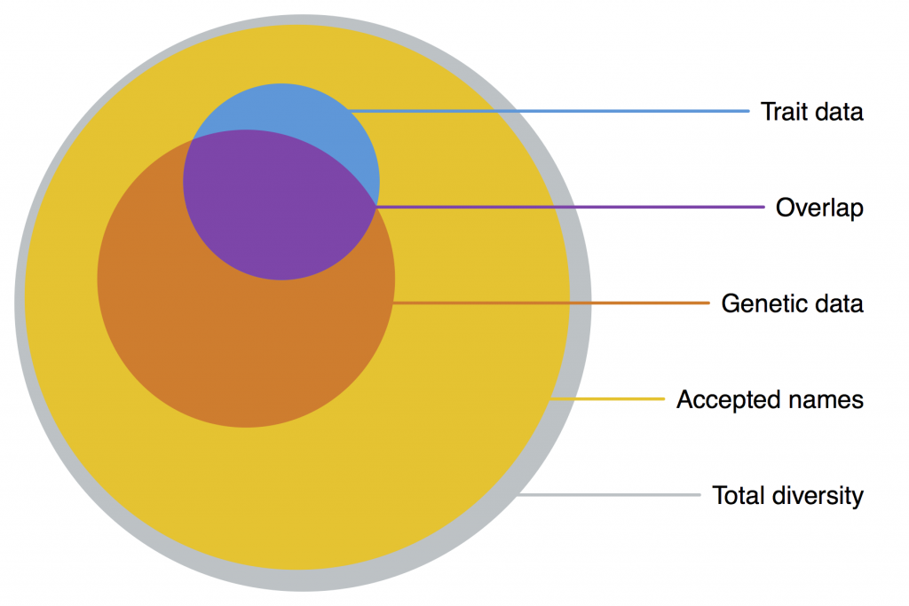
The problem...
Functional Position of Aliens
Wanted to study the “Biotic Resistance Hypothesis” globally in the Tropics with a functional lens
Huge gaps in trait data for alien species
Cornwell et al. 2019
What do we know of functional traits of alien (plant) species at global scale?
<numéro>

Slide 4




Merging Alien Plant Species Lists and Global Traits
(Open) Trait Data
Alien status and distribution
Taxonomic Harmonization (Grenié et al. 2022) + Trait Harmonization + Trait Categorization
16,538 species from GloNAF → 15,490 species with at least one trait (consolidated data)
<numéro>

Slide 5
Global Trait Matrix
1 pixel = 1 trait x 1 species
98% of trait matrix is empty
We are lacking much of alien plant species traits
<numéro>

Slide 6
20 most measured traits are mostly categorical
Most traits measured for <50% of species
Plant height is the first continuous trait
Available for ~70% of species
Seed mass is the second continuous trait
Available for ~50% of species
<numéro>

Slide 7
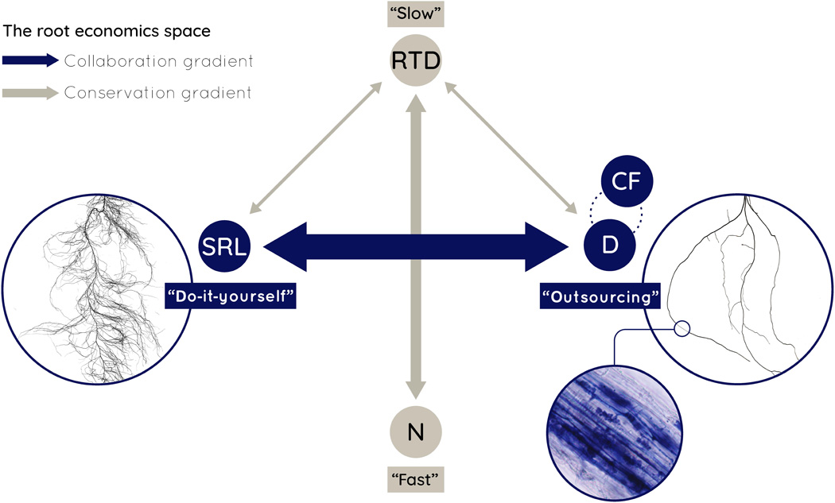
Trait Combinations
Species (16,538) x Traits (2,215) matrix is big
Reduce complexity → trait combinations
Leaf-Height-Seed Mass Westoby et al. 1999 3 traits
Aboveground Traits Díaz et al. 2016 6 traits
Root Traits Bergmann et al. 2020 4 traits
Specific Leaf Area
Height
Seed Mass
<numéro>

Slide 8
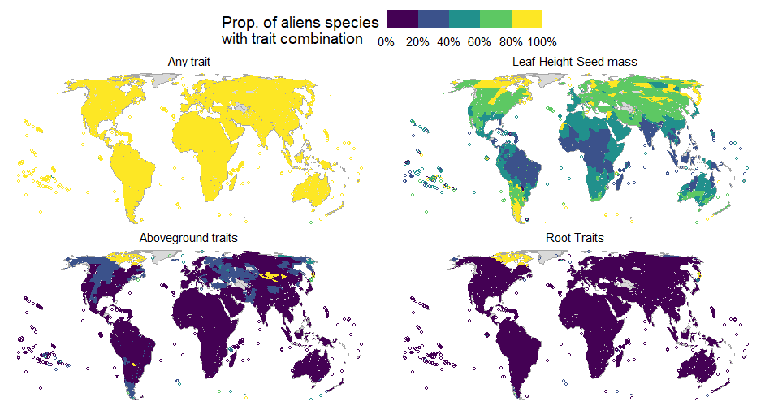
We have global gaps in trait combinations
<numéro>

Slide 9
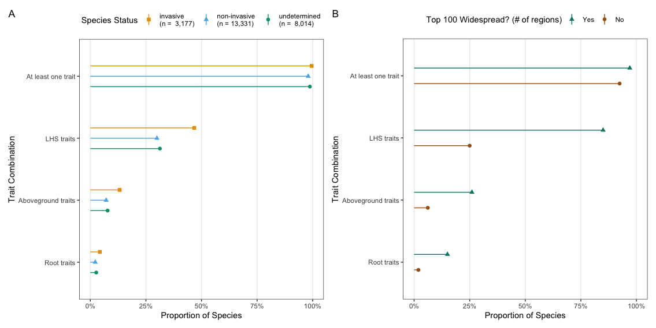
Widespread and Invasive Species are better known
<numéro>

Slide 10
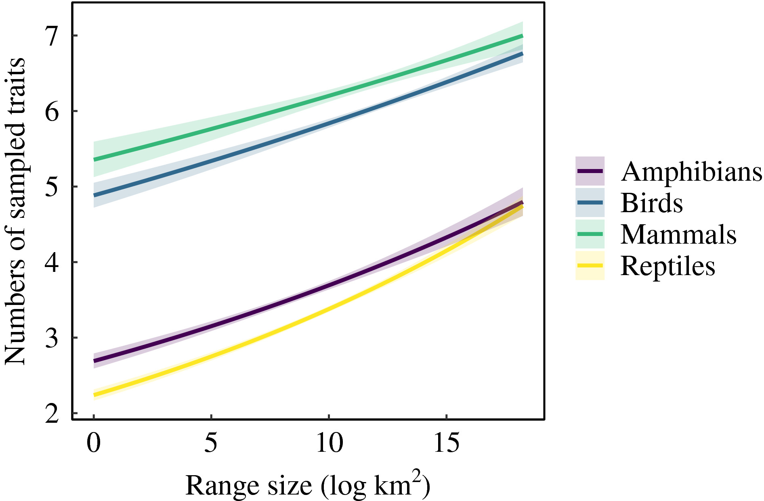
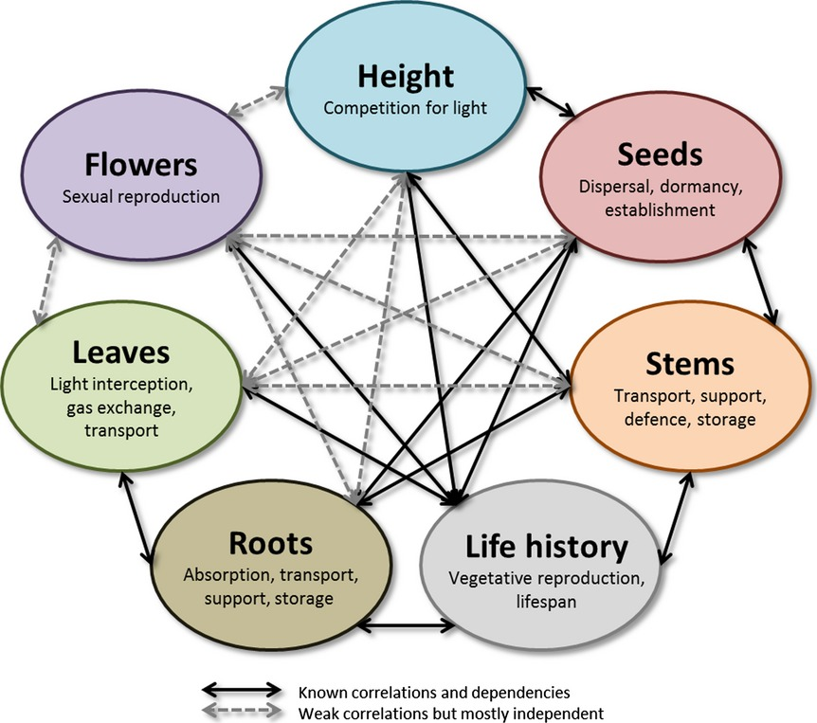
Perspectives
Identify the drivers of trait knowledge in alien species (range size, country of origin, growth form, invasiveness, etc.)
Analyze amount of geolocated information (trait provenance)
Prioritize species/regions/traits on which to close the gaps → costs, heavily invaded region, easy to “close” region
Etard et al. 2020
Laughlin 2014
<numéro>

Slide 11



Closing the trait gaps?
Scientific Literature (+Floras?)
Distributed Field Campaign
Call for data contributions
Recent Examples LT-Brazil (Mariano et al. 2021) FunAndes (Baez et al. 2022)
We need a coordinated global effort to close the trait gaps
<numéro>

Slide 12
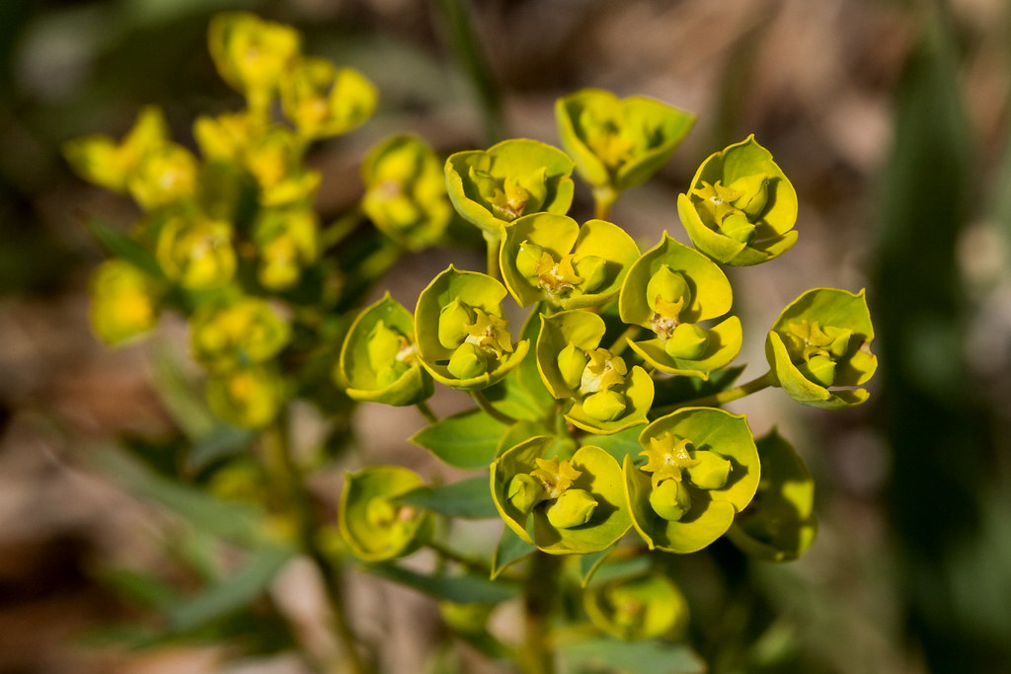
matthias.grenie@idiv.de
@LeNematode
https://rekyt.github.io/
Thank you!
<numéro>

